Slide 1

Experiences of PyCon UK 2012
Daley Chetwynd
ThoughtWorks
@dchetwynd

Slide 2
Contents
Python Sheffield, Tuesday October 30th 2012
Introduction
Conference information
Daily sessions
Lightning talks
Conclusions

Slide 3
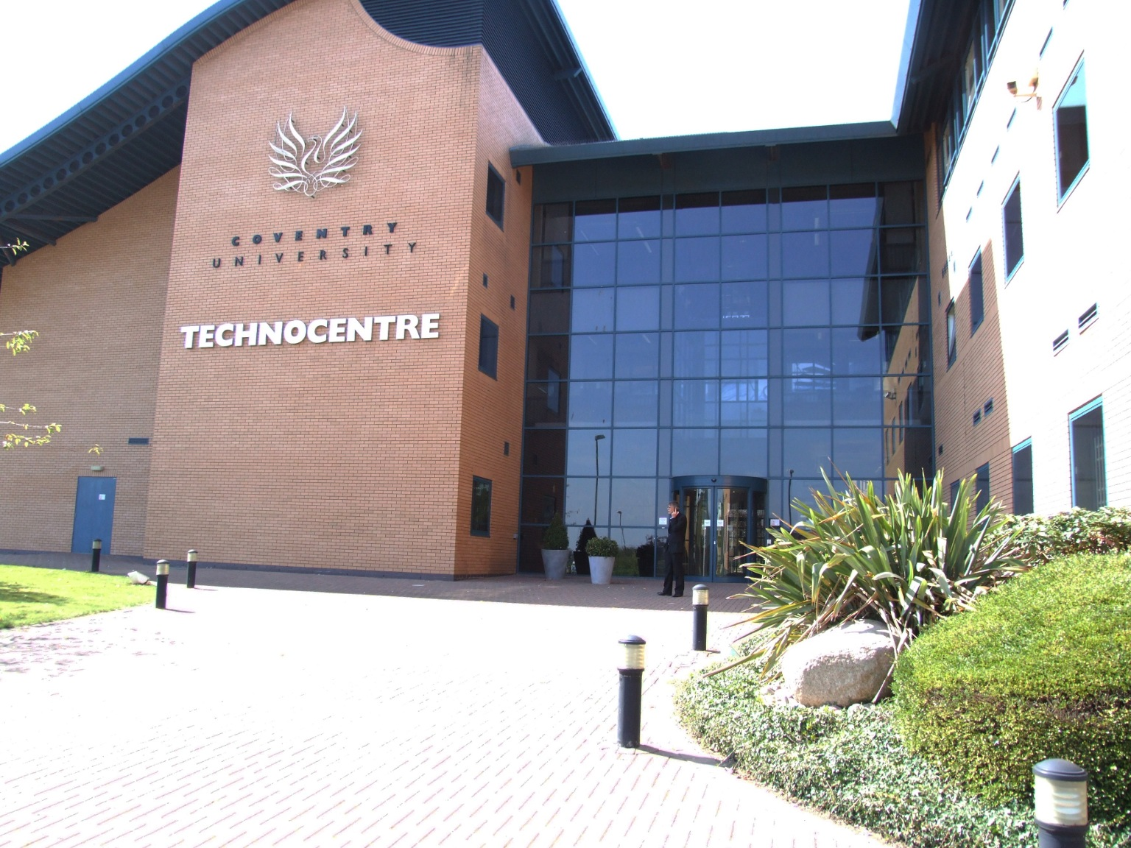
Introduction
Python Sheffield, Tuesday October 30th 2012
PyCon UK is UK’s only national Python language conference
Held at TechnoCentre in Coventry for second year running
Ten minutes walk from Coventry train station

Slide 4
Conference Information
Python Sheffield, Tuesday October 30th 2012
4-day conference (Fri Sept 28th – Mon Oct 1st)
235 attendees (increased from 179 attendees in 2011)
Early-bird tickets £99, standard tickets £170, late tickets £199
TechnoCentre main room held approximately 150 people
Five parallel sessions over all five days
Canteen with lunches provided, free coffee all day and mezzanine chill-out balcony with sofas

Slide 5
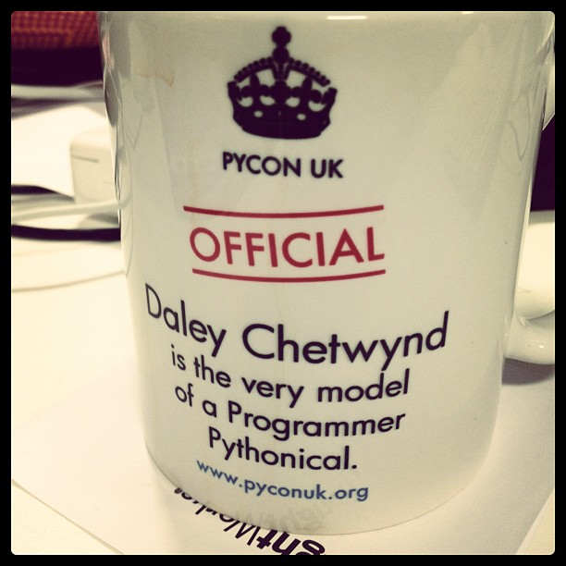
Conference Information
Python Sheffield, Tuesday October 30th 2012
All attendees provided with customised PyCon UK mug and t-shirt
Friday night pub social sponsored by Python Anywhere
Saturday night conference dinner included in ticket price
Visits to Coventry cathedral, medieval Guild Hall and museums organised for partners

Slide 6
Friday sessions
Python Sheffield, Tuesday October 30th 2012
Friday quieter than Saturday and Sunday
Guide to development sprints by Jacob Hallen
All-day Test-driven development with Django, TDD and Selenium
Intermediate Python tutorial held all day
All-day Trac sprint
All-day Evidence for Development sprint

Slide 7
Saturday sessions
Python Sheffield, Tuesday October 30th 2012
Keynote on “Raspberry Pi: The Software Story” by Alex Bradbury
All-day Introduction to Python session
Talks on fuzzy error handling, docopt, decorators and context managers, DjangoPi Project, minimalism in software development
Afternoon Code Dojo for two hours
Lightning talks for one hour
Evening keynote “Remaking the PSF” by Van Lindberg

Slide 8
Sunday sessions
Python Sheffield, Tuesday October 30th 2012
Morning teaching resources sprint and Python core development sprint
Talks on SciPy documentation, text search with Trac, Alice’s Adventures in Programming, Concurrency with CSP and Python-powered rich apps
PyCon UK panel discussion with five members
Lightning talks for two hours
Evening social at Oriental Palace restaurant

Slide 9
Monday sessions
Python Sheffield, Tuesday October 30th 2012
Monday mostly dedicated to development sprints only
Intention to introduce more sprint contributors from conference attendees
Python and Raspberry Pi sprint
Python core development sprint, rich applications sprint and evidence for development sprint
Listen again talks also held on Monday

Slide 10
Lightning talks
Python Sheffield, Tuesday October 30th 2012
Hosted by “Lightning Talk Man”
Strictly limited to five minutes per talk
Lightning talks are mixture of interesting projects and comedy talks
Well attended by enthusiastic audience

Slide 11
Conclusions
Python Sheffield, Tuesday October 30th 2012
PyCon UK had grown from 2 days and 179 attendees to 4 days and 235 attendees
Wide range of topics covered
Several coding sessions provided, including tutorials for newer Python users
Development sprints incorporated throughout conference
Friendly atmosphere
PyCon European cruise planned for spring 2013

Slide 12
Python Sheffield, Tuesday October 30th 2012
Questions?

